Slide 1
AI & NN Unit II – Part 1
Topics: Knowledge representation - Game playing - Predicate logic, Introduction to Predicate calculus,
Resolution, use of predicate calculus,
Class: III CYS
Sem : 2025-26, Sem 5
-Dr. S.Durga, M.E., PhD

Slide 2
In Artificial Intelligence (AI), reasoning plays a crucial role in building systems that can make decisions and infer knowledge based on facts and conditions.
One option in AI is propositional logic, but is limited in its ability to represent complex relationships or detailed information.

Slide 3
Knowledge Representation using Predicate Logic in AI:
Predicates are a means of representing knowledge in a structured and formal manner. In AI, representing knowledge is essential for machines to understand and reason about the world.
Predicates allow for the precise description of properties and relationships among objects, which can be used to build knowledge bases.

Slide 4
Knowledge representation
Knowledge representation in AI refers to the methods used to encode information about the world into a format that an AI system can understand and use to make decisions.
It is a crucial component of AI that bridges the gap between raw data and meaningful reasoning.

Slide 5
Predicate logic
Predicate logic, also known as first-order logic (FOL), extends propositional logic by allowing AI systems to represent relationships between objects and their properties.
This makes predicate logic a powerful tool for knowledge representation and reasoning.
It enables AI systems to understand relationships like “John is the father of Mary” or “All humans are mortal.”

Slide 6
Role of Predicate Logic in AI
Unlike propositional logic, which deals with simple true/false statements, predicate logic introduces predicates, variables, constants, and quantifiers. These elements help in modeling real-world problems that involve multiple objects and their interactions.
Knowledge Representation: It provides a structure for representing complex facts about objects and their relationships in a system.
Reasoning: AI systems use predicate logic to infer new information from existing facts, making it suitable for decision-making tasks.

Slide 7
Example
John is the father of Mary”
can be represented as:
Father(John,Mary)
Likes(Alice, Bob), where "Likes" is the predicate

Slide 8
Components of Predicate Logic:
key components : to represent relationships and properties of objects in a structured way.
Predicates:
A predicate is a function that returns either true or false based on the relationship between its arguments.
Example: IsHungry(John). This predicate represents whether John is hungry, returning true if he is and false if not.

Slide 9
2. Variables:
Variables are placeholders for objects within a domain. They allow us to represent general statements that apply to multiple objects.
Example: In IsHungry(x), the variable x can represent any person.

Slide 10
3. Constants:
Constants represent specific objects or entities in the domain.
Example: John is a constant in the predicate IsHungry(John).

Slide 11
Structure of Predicates
Predicate consists of two key elements: the predicate symbol and arguments. Predicates are enhanced with quantifiers to specify the scope of variables involved.
1. Predicate Symbol
The predicate symbol defines the property or relationship being described.
Example:
IsHungry(x) represents whether a person (x) is hungry.
Married(x, y) denotes that person x is married to person y.
Predicates are named based on the relationship or property they represent. The symbol is followed by arguments enclosed in parentheses.

Slide 12
2. Arguments and Arity
Arguments refer to the specific objects that the predicate is applied to.
The arity of a predicate refers to the number of arguments it takes.
Examples:
IsHungry(x): A predicate with 1 argument (arity = 1).
Married(x, y): A predicate with 2 arguments (arity = 2).
X(a, b, c): A predicate with 3 arguments (arity = 3), representing something like “a + b + c = 0.”

Slide 13
3. Quantifiers in Predicate Logic
Quantifiers allow us to specify the scope of variables. There are two main types:
Existential Quantifier ( ∃ )
Meaning: There exists at least one object that satisfies the given condition.
Example: ∃x IsHungry(x) This statement means that at least one person is hungry.
Negation: The negation of the existential quantifier means that no such object exists. ¬∃x IsHungry(x) This means that no one is hungry.
Universal Quantifier ( ∀ )
Meaning: The given condition holds for all objects in the domain.
Example: ∀x (IsHuman(x)→IsMortal(x)) This means that all humans are mortal.
Negation: The negation of the universal quantifier means there is at least one exception. ¬∀x IsHuman(x)→IsMortal(x) This implies that at least one human is not mortal.

Slide 14
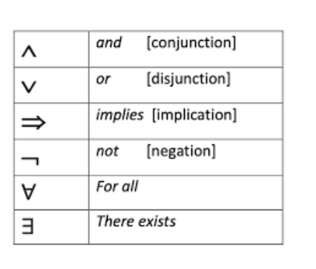

Slide 15
Examples of Predicate Logic
1. Simple Predicate Example:
Predicate: IsHungry(John)
Meaning: This predicate represents the state of whether John is hungry. It takes one argument (John) and returns true if John is hungry, otherwise false.
Application in AI:
In NLP-based chatbots, predicates like this could help infer the user’s intent. For example, if a chatbot detects that the user is hungry, it could suggest nearby restaurants.

Slide 16
2. Equality Predicate Example:
Predicate: E(x,y)≡(x=y)
Meaning: This predicate denotes that x is equal to y. It returns true if the two objects are identical.
Application in AI:
AI-based reasoning systems use equality predicates to match objects. For example, in a robot warehouse, a robot may use this predicate to determine if an object picked matches the one requested (e.g., E(Package1, RequestedItem)).

Slide 17
3. Mathematical Predicate Example:
Predicate: X(a,b,c)≡(a+b+c=0)
Meaning: This predicate checks whether the sum of a, b, and c equals zero. It returns true if the equation holds, otherwise false.
Application in AI:
In optimization problems, AI models might use mathematical predicates to check if constraints are satisfied. For example, in scheduling systems, such predicates can validate if certain conditions are met (e.g., X(shiftA, shiftB, totalTime) checks if the total shift hours are balanced).

Slide 18
4. Relationship Predicate Example:
Predicate: M(x,y)≡x is married to y
Meaning: This predicate expresses a relationship between two objects, indicating that x is married to y.
Application in AI:
In family tree AI systems, relationship predicates are used to infer relationships among family members. For instance, if M(John, Mary) is true, the system can infer that John is Mary’s spouse.

Slide 19
Universal Quantification Example:
Expression: ∀x (IsHuman(x)→IsMortal(x))
Meaning: This statement reads as “For all x, if x is human, then x is mortal.” It applies to every object in the domain of humans. If an object is found to be human, it must also be mortal for the statement to hold true.
Application in AI:
Knowledge-based systems use such rules to infer properties about objects. For example, in medical diagnosis systems, rules like “All viruses can spread infections” (∀x IsVirus(x) → CanSpreadInfection(x)) help the system reason about diseases.

Slide 20
6. Existential Quantification Example:
Expression: ∃x IsHungry(x)
Meaning: This reads as “There exists at least one x such that x is hungry.” It indicates that at least one object in the domain satisfies the condition of being hungry.
Application in AI:
In robot planning, a robot could use existential quantifiers to plan actions. For example, “There exists a task that requires charging” (∃x TaskRequires(x, Charging)) might guide the robot to prioritize charging tasks.

Slide 21
7. Compound Example with Multiple Quantifiers:
Expression: ∀x∃y (Parent(x,y))
Meaning: This statement means “For every person x, there exists a person y such that x is the parent of y.” It shows how multiple quantifiers can be used together to represent complex relationships.
Application in AI:
This logic is often used in social network AI models to analyze relationships. In a family tree system, the model could use such logic to infer relationships between family members.

Slide 22
Other applications of predicate logic in AI
Reasoning: Predicates and quantifiers facilitate logical reasoning in AI systems. They enable the formulation of logical queries and the inference of new information from existing knowledge. AI systems can use predicates to perform tasks like deductive reasoning, semantic query answering, and decision making. For example, an AI system can infer that if "x is a parent of y" and "x is a human," then "y is also a human."

Slide 23
Other applications of predicate logic in AI
Database Systems: Predicates are used extensively in database systems, which are integral to many AI applications. In databases, predicates define conditions for querying and retrieving information.
For instance, SQL (Structured Query Language) relies on predicates for filtering and searching database records.

Slide 24
Other applications of predicate logic in AI
Expert Systems: Expert systems, a type of AI system designed to emulate the decision-making abilities of a human expert in a specific domain, often use predicates to represent domain knowledge. Predicates can capture rules, facts, and heuristics, allowing expert systems to make informed decisions and solve problems.

Slide 25
Other applications of predicate logic in AI
Natural Language Processing: Predicates are used in natural language processing for understanding the semantics of sentences. Parsing a sentence into predicate-argument structures can help AI systems extract meaning from text and generate structured knowledge representations from unstructured text.
Machine Learning: In machine learning, predicates can be used as features for training models. For instance, predicates can represent attributes of data objects, allowing machine learning algorithms to discover patterns and make predictions based on those predicates.

Slide 26
Difference Between Predicate Logic and Propositional Logic
Aspect | Predicate Logic | Propositional Logic
Definition | Extends propositional logic by allowing variables and relationships between objects. | Deals with simple statements that are either true or false.
Elements | Uses predicates, variables, constants, and quantifiers. | Uses atomic propositions (simple statements).
Expressiveness | More expressive; can represent relationships and properties. | Less expressive; limited to simple true/false statements.
Example | ∀x (IsHuman(x) → IsMortal(x)) | It is raining (P).
Quantifiers | Supports existential (∃) and universal (∀) quantifiers. | No quantifiers are used.
Handling of Relationships | Can represent complex relationships, like Parent(John, Mary). | Cannot represent relationships between objects.
Applications | Used in NLP, expert systems, and robot planning. | Used in decision-making systems with simpler conditions.
Complexity | More complex due to the use of variables and quantifiers. | Simpler with fewer components.
Reasoning Capability | Enables inference through rules and relationships. | Limited to evaluating truth values of propositions.

Slide 27
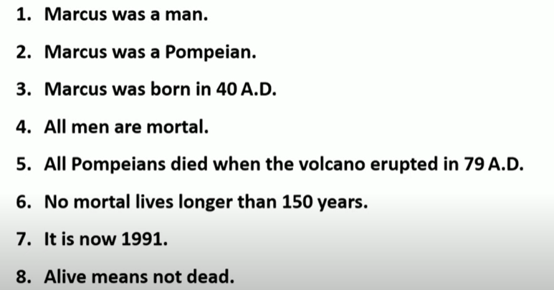
Homework: convert the following sentence to formulas in predicate logic

Slide 28
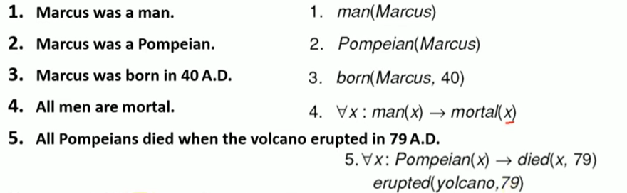
Solution

Slide 29
Recall..
Predicate calculus, also known as first-order logic, is a powerful tool for knowledge representation in AI, allowing for the formalization of facts and relationships between objects.
Other knowledge representation methods include semantic networks and frames, which offer alternative ways to structure and organize knowledge.

Slide 30
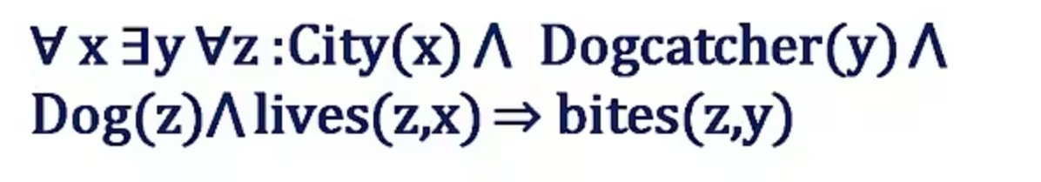
Convert the following into statement
Ans:
For every city, there exists a dogcatcher such that every dog that lives in that city bites that dogcatcher.

Slide 31
Convert the following into statement
∀n∃a∀t: Network(n) ∧ Admin(a) ∧ Threat(t) ∧ targets(t,n) ⇒ blocks(a,t)
Network(n): n is a network
Admin(a): a is a system administrator
Threat(t): t is a cyber threat
targets(t, n): threat t targets network n
blocks(a, t): admin a blocks threat t
For every network, there exists a system administrator such that every threat that targets that network is blocked by that administrator.

Slide 32
Convert the following into statement
∀u∀s:User(u) ∧ System(s) ∧ accesses(u,s) ⇒ authenticated(u)∧authorized(u,s)
User(u): u is a user
System(s): s is a system
accesses(u, s): user u accesses system s
authenticated(u): user u is authenticated
authorized(u, s): user u is authorized to access system s
If a user accesses a system, then the user is authenticated and authorized to access that system.

Slide 33
Find Predicate Logic Formula
For every user and every device, if the device is stolen or compromised, and it belongs to the user, then the user revokes access for that device.
User(u): u is a user
Device(d): d is a device
stolen(d): device d is reported stolen
compromised(d): device d is compromised (e.g. infected with malware)
revokesAccess(u, d): user u revokes access for device d
Ans:
∀u∀d: User(u) ∧ Device(d) ∧ (stolen(d) ∨ compromised(d)) ⇒ revokesAccess(u,d)

Slide 34
Resolution
Resolution, a proof technique in predicate calculus, uses logical inference to determine the truth of statements.
It involves converting statements to clause form, adding the negation of the statement to be proven, and then deriving a contradiction (the empty clause) through resolution steps.
Inference: Predicate logic allows for inference, enabling AI systems to derive new knowledge from existing facts. Resolution, in particular, is a method for proving theorems by contradiction.

Slide 35
Resolution for Theorem Proving:
Refutation-based: Resolution works by refutation, meaning it aims to prove a statement by showing that its negation leads to a contradiction.
Steps:
Conversion to Clause Form: Statements in predicate calculus are converted into conjunctive normal form (CNF), which is a set of clauses (disjunctions of literals).
Negation: The negation of the statement to be proven is added to the set of clauses.
Resolution: The resolution rule is applied to pairs of clauses that contain complementary literals (a literal and its negation). This process generates a new clause (resolvent) that is a logical consequence of the original clauses.
Contradiction: The process continues until the empty clause (representing a contradiction) is derived, proving the original statement.

Slide 36
prove the statement using resolution
“If a user logs in from a blacklisted IP address and the login attempt is unauthorized, then the system should trigger an alert”.

Slide 37
∀x (BlacklistedIP(x) ∧ UnauthorizedLogin(x) → Alert(x))
Given Knowledge Base (Predicate Logic):
BlacklistedIP(ip123)
UnauthorizedLogin(ip123)
∀x (BlacklistedIP(x) ∧ UnauthorizedLogin(x) → Alert(x))

Slide 38
Step 1: Convert to Clause Form (CNF)
The implication is converted:
∀x(¬BlacklistedIP(x)∨¬UnauthorizedLogin(x)∨Alert(x))∀x (¬BlacklistedIP(x) ∨ ¬UnauthorizedLogin(x) ∨ Alert(x))∀x(¬BlacklistedIP(x)∨¬UnauthorizedLogin(x)∨Alert(x))
Instantiate for ip123:
¬BlacklistedIP(ip123) ∨ ¬UnauthorizedLogin(ip123) ∨ Alert(ip123)
Facts:
BlacklistedIP(ip123)
UnauthorizedLogin(ip123)

Slide 39
Step 2: Negation of the Goal
Assume negation of what we want to prove:
"The system did not trigger an alert for ip123"
So add:
¬Alert(ip123)

Slide 40
Step 3: Resolution Steps
Clause A: BlacklistedIP(ip123) Clause B: UnauthorizedLogin(ip123) Clause C: ¬BlacklistedIP(ip123) ∨ ¬UnauthorizedLogin(ip123) ∨ Alert(ip123) Clause D: ¬Alert(ip123)
Step 3.1:
Resolve Clause C and Clause D: Result: ¬BlacklistedIP(ip123) ∨ ¬UnauthorizedLogin(ip123)
Step 3.2:
Resolve with Clause A: Result: ¬UnauthorizedLogin(ip123)
Step 3.3:
Resolve with Clause B: Result: □ (empty clause)
We've reached a contradiction, so our assumption (¬Alert(ip123)) is false.
Hence, the original statement is logically valid:
If an IP is blacklisted and the login is unauthorized, then an alert will be triggered.

